Slide 1


Every Oil Well Tells a Story

Slide 2
First Part Outline
Keywords Definition
Similarity
Clustering
Clustering Issues

Slide 3
Sample
Feature
Label
Data Set

Slide 4
Similarity

Slide 5
Words Similarity
Man
Dog
King
Kiwi
Cat
Three
Woman
Four
Orange
Five
Queen
Apple

Slide 6
Words Similarity
Man
Dog
King
Kiwi
Cat
Three
Woman
Four
Orange
Five
Queen
Apple
Man
Woman
King
Queen
Cat
Dog
Three
Four
Five
Kiwi
Apple
Orange

Slide 7
Clustering

Slide 8
Word Clustering
Man
Dog
King
Kiwi
Cat
Three
Woman
Four
Orange
Five
Queen
Apple
Man
Queen
King
Woman
____________
Cat
Dog
____________
Four
Three
Five
____________
Kiwi
Apple
Orange
Man
Woman
King
Queen
Cat
Dog
Three
Four
Five
Kiwi
Apple
Orange

Slide 9
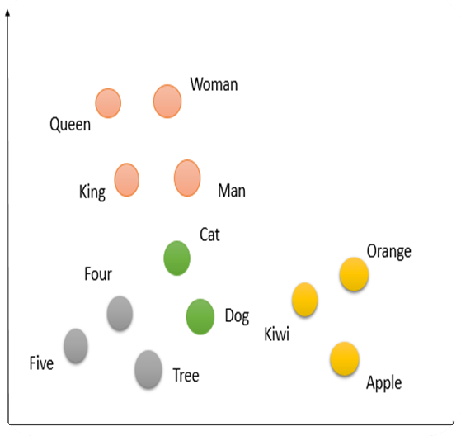
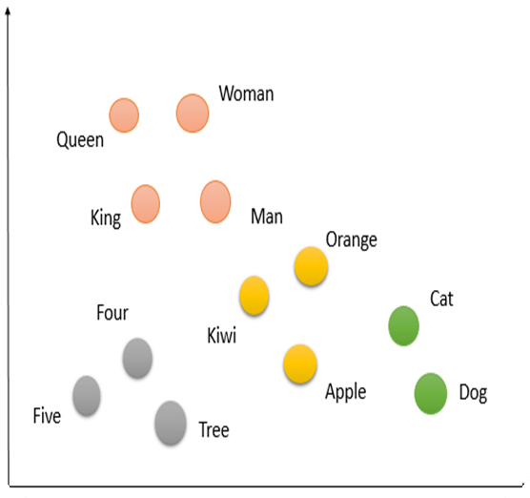
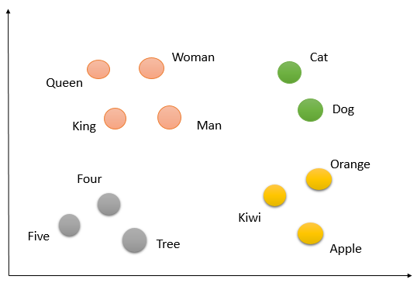
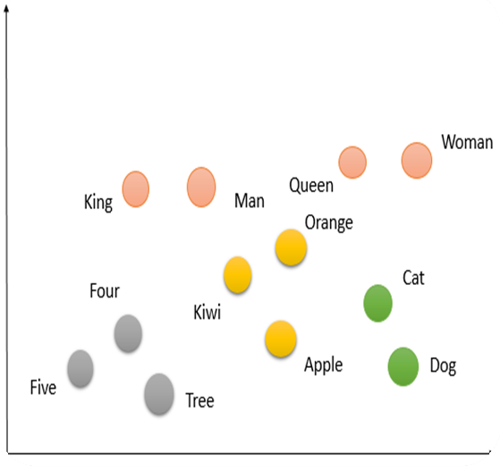
Word Clustering
Man
Woman
King
Queen
___________
Cat
Dog
___________
Three
Four
Five
___________
Kiwi
Apple
Orange

Slide 10
Word Clustering

Slide 11
Word Clustering

Slide 12
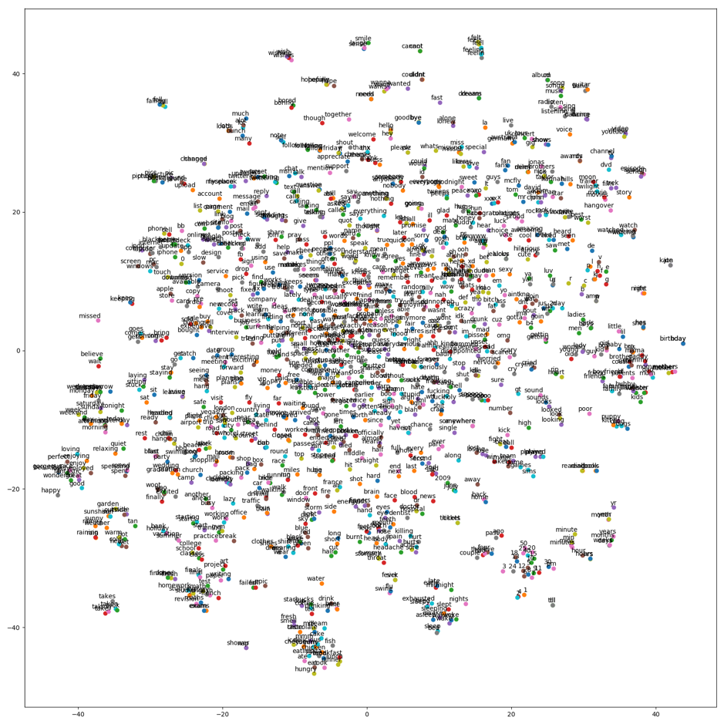
Word Clustering Issues

Slide 13
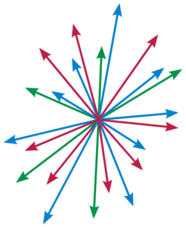
Word Clustering Issues

Slide 14
Oil Well Clustering Issues
它的目的是
提供尽
可能精
精确且便
提供
古代原典
尤其先
秦两汉
文献
资料
提示
底本

Slide 15
Word Clustering
它的目的是
提供尽
可能精
精确且便
提供
古代原典
尤其先
秦两汉
文献
资料
提示
底本
??
??
??
??
____________
??
??
____________
??
??
??
____________
??
??
??
??
??
??
??
??
??
??
??
??
??
??
??

Slide 16
Clustering Issues
它的目的是
提供尽
可能精
精确且便
提供
古代原典
尤其先
秦两汉
文献
资料
提示
底本

Slide 17
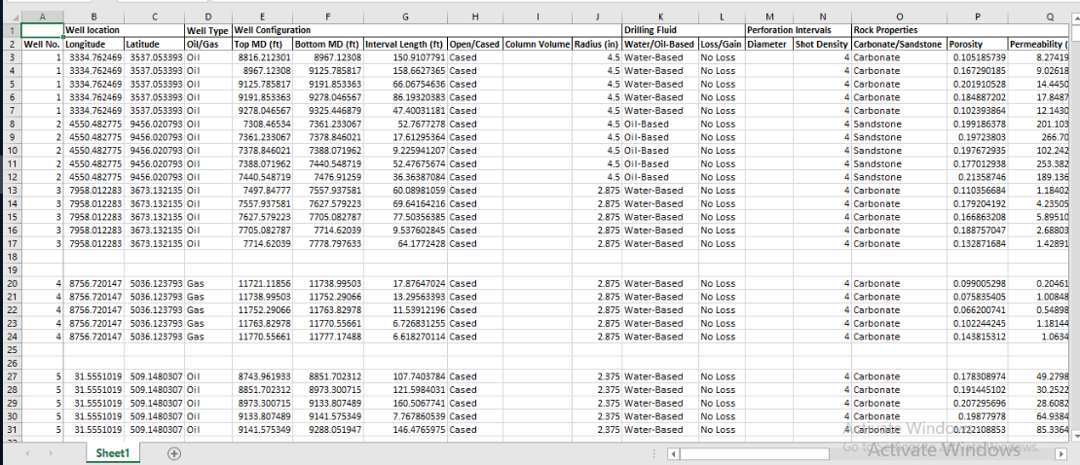
Data Set

Slide 18
Oil Well Clustering Issues
它的目的是
提供尽
可能精
精确且便
提供
古代原典
尤其先
秦两汉
文献
资料
提示
底本

Slide 19
Descriptive Analytics

Slide 20
Oil/Gas Feature

Slide 21
Carbonate Sandstone Feature
Carbonate Sandstone Distribution
Sandstone
25%
Carbonate
75%

Slide 22
Open Cased Feature
75%
25%
cased
open

Slide 23
Oil/Water-Based Feature

Slide 24
Loss/No Loss Feature
7%
93%
Loss
No Loss

Slide 25
Wettability Feature
Wettability Distribution
Mixed-Wet
50%
25%
Oil-Wet
Water-Wet
25%

Slide 26
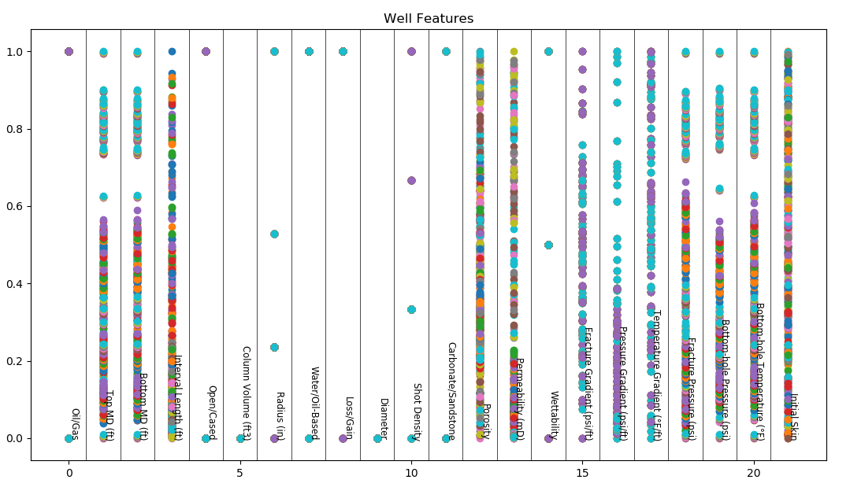
Distribution of features
Notes:
تفکیک پذیری برخی پارامترها
تصمیم گیری متخصص ها بیشتر بر اساس پارامترهای گسسته

Slide 27
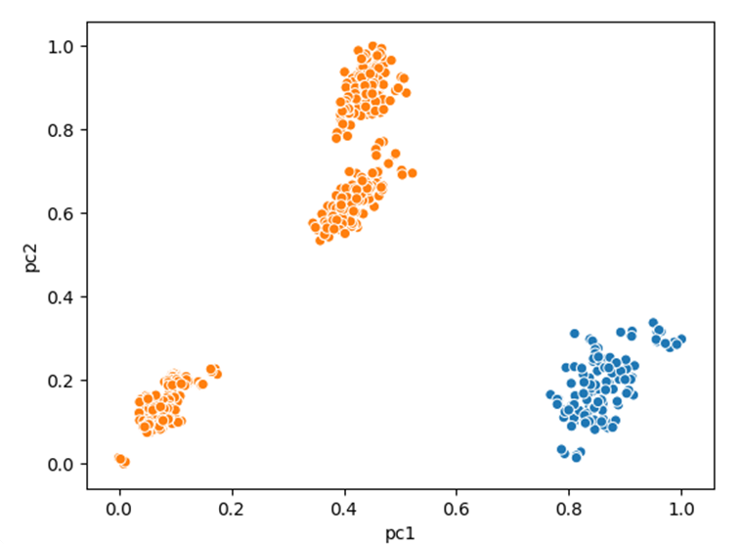
Distribution of features

Slide 28
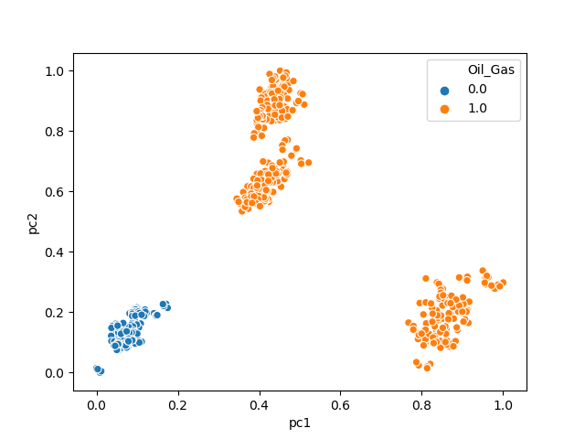
Distribution of features

Slide 29
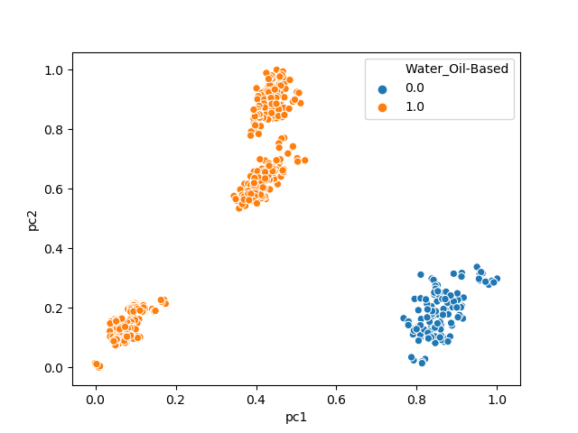
Distribution of features

Slide 30
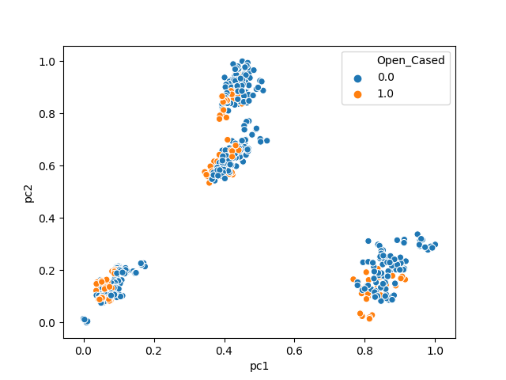
Distribution of features

Slide 31
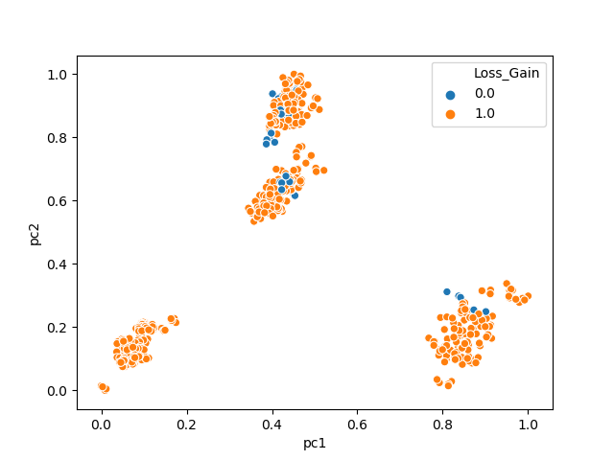
Distribution of features

Slide 32
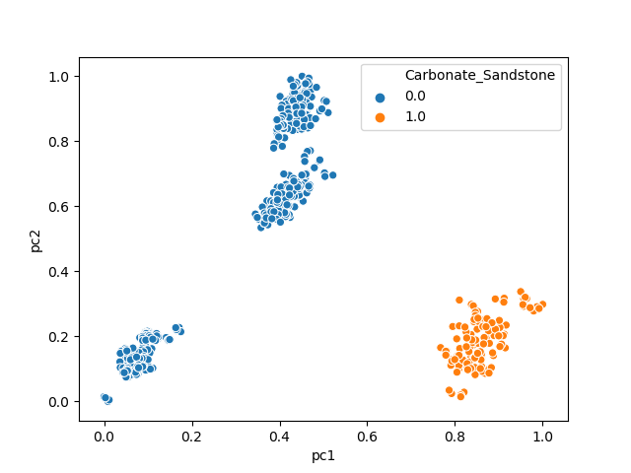
Distribution of features

Slide 33
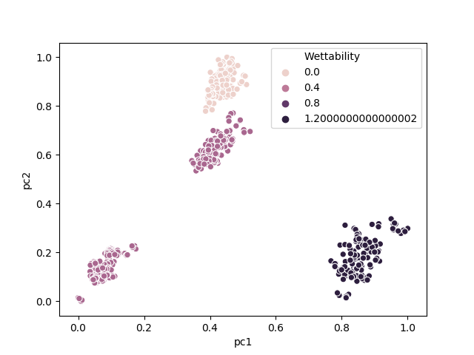
Distribution of features

Slide 34
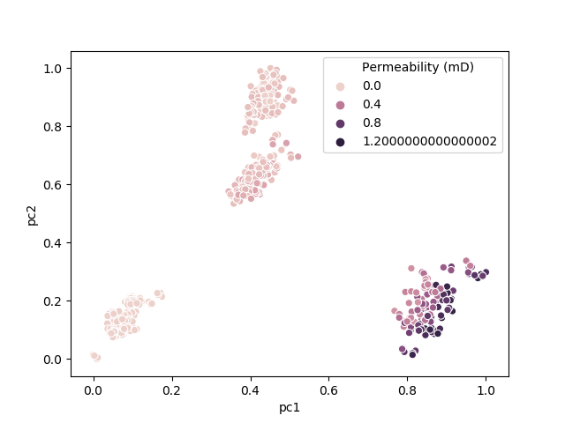
Distribution of features

Slide 35
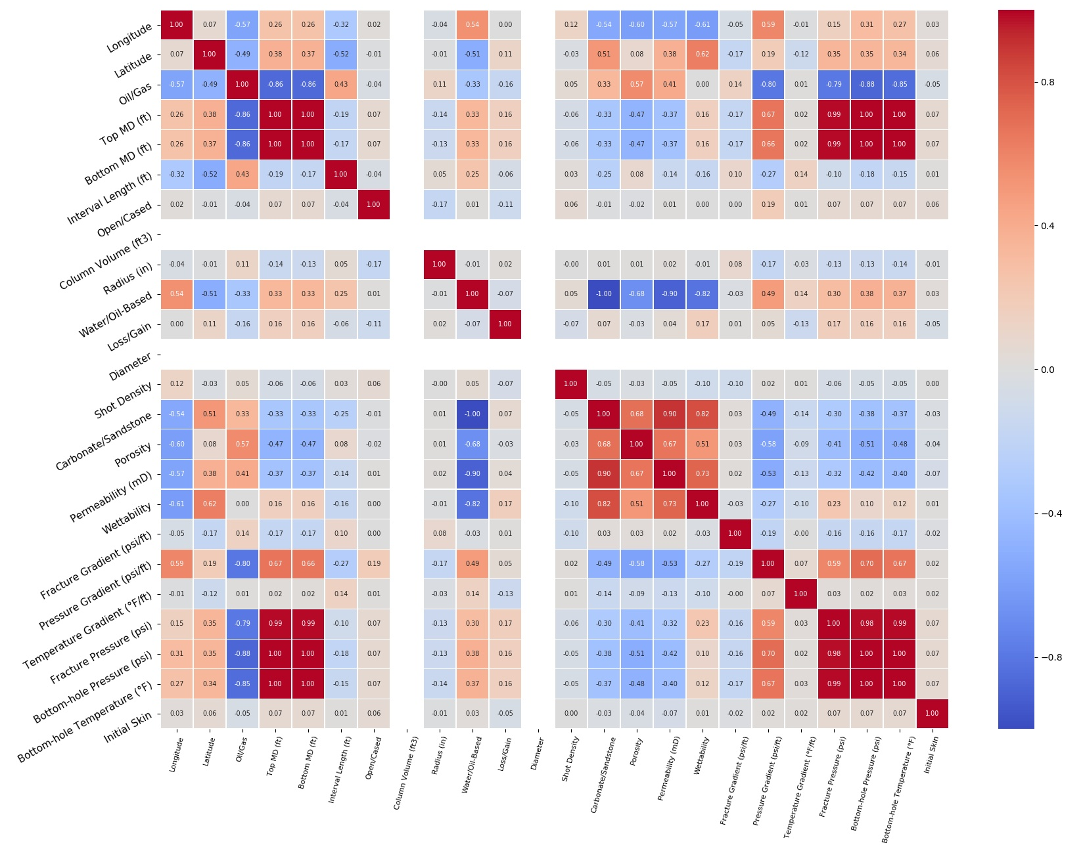
Correlation Hit Map

Slide 36
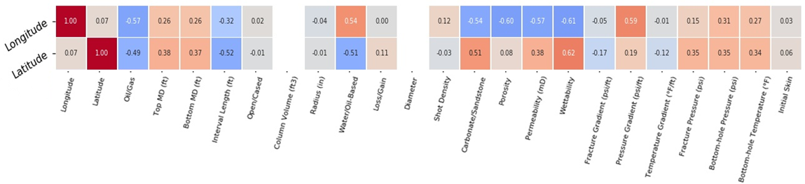
Correlation Hit Map

Slide 37
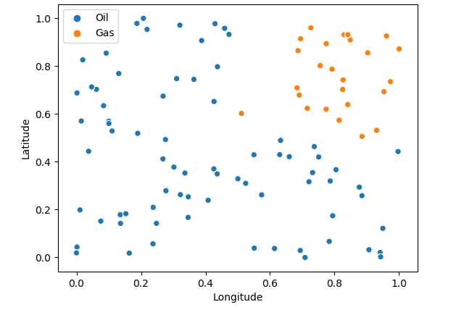
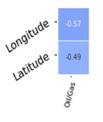
Oil or Gas Wells Based On it’s Locations

Slide 38
Correlation Hit Map

Slide 39
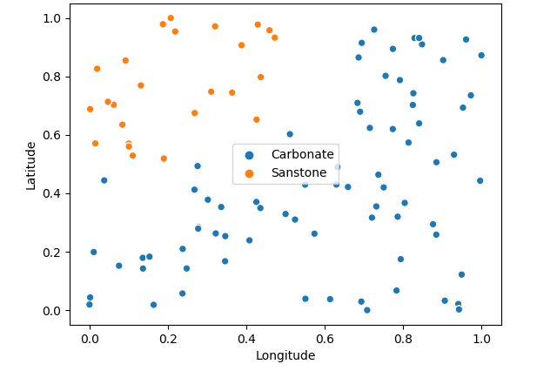
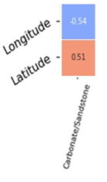
Carbonate Or Sandstone wells Based On it’s Locations

Slide 40
Correlation Hit Map

Slide 41
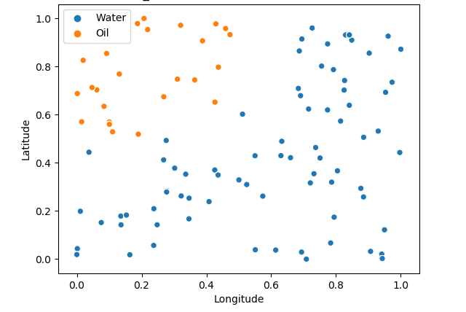
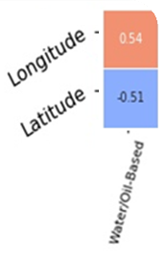
Water-Based or Oil-Based wells and it’s Locations

Slide 42
Similarity Detection

Slide 43
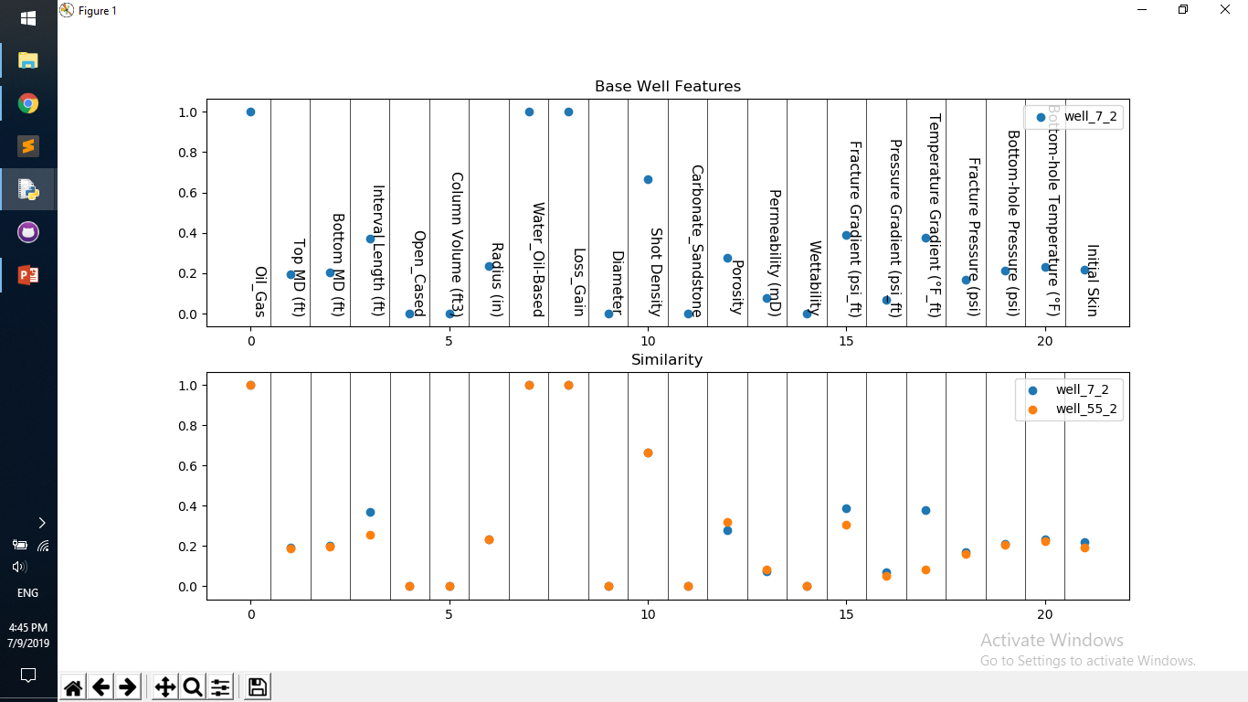

Slide 44
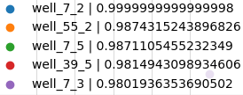

Slide 45
THANK YOU

Slide 48
Questions
What is Machine Learning?
What is Data Analysis?
How it would be effective?

